Slide 1
Online ITR Filing Process
BENEFITS
Easy and Convenient
Fast process
Online Payment option
Online Tax Payment
You can click on this link
app.makemeeasy.in/

Slide 2
PROCESS
Registration
Step – 1
Choose your Source of Income
Pay fee online
Step – 2
Your personal details, bank details, residential status.
Step -3
Upload your Form 16 and other documents.

Slide 3
Registration Process
Once you click on the link, you will reach on registration page, where you need to fill the following 4 details
1) E-mail
2) Mobile Number
3) PAN
4) Date of Birth

Slide 4
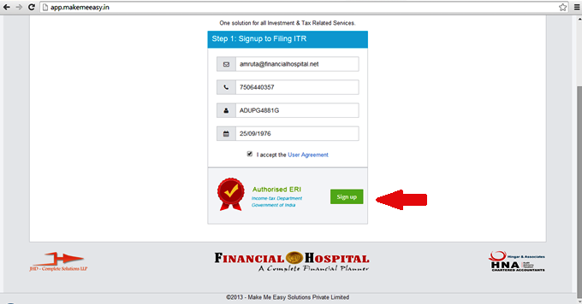
Registration Page
Once you sign up your account will be created and detail will be sent to your registered email ID and contact number .

Slide 5
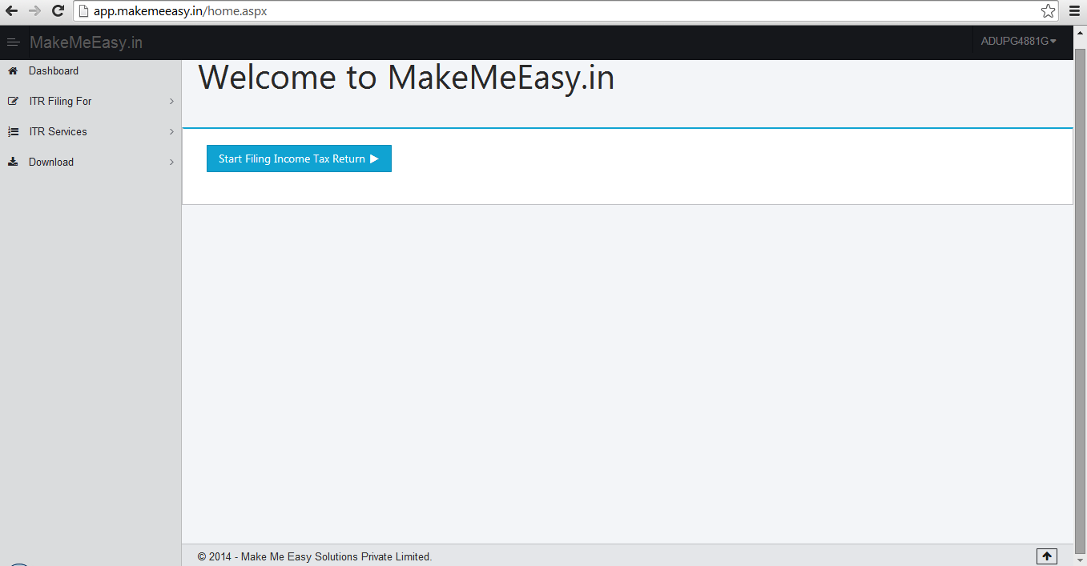
You will be land to home page.
Then, Click on “ Start Filling Income Tax Return”.

Slide 6
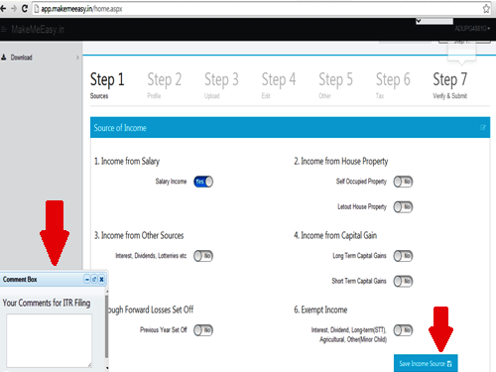
Step 1 – Select Source of Income and Pay online
In this step you need to select your source of income. Ex. If you have Salary, House Property and Capital Gain Income. You need to select Income from Salary, Income from House Property and Income from Capital Gain.

Slide 7
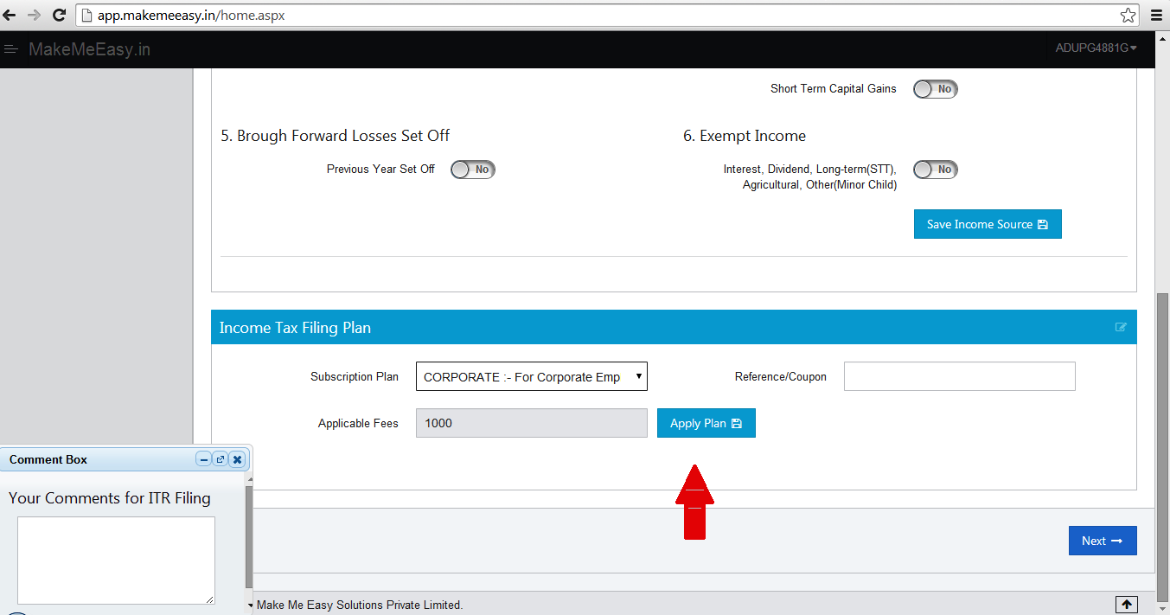
Payment Options
For payment option you can select one of the following : -
Net Banking
Credit Card
Debit Card

Slide 8
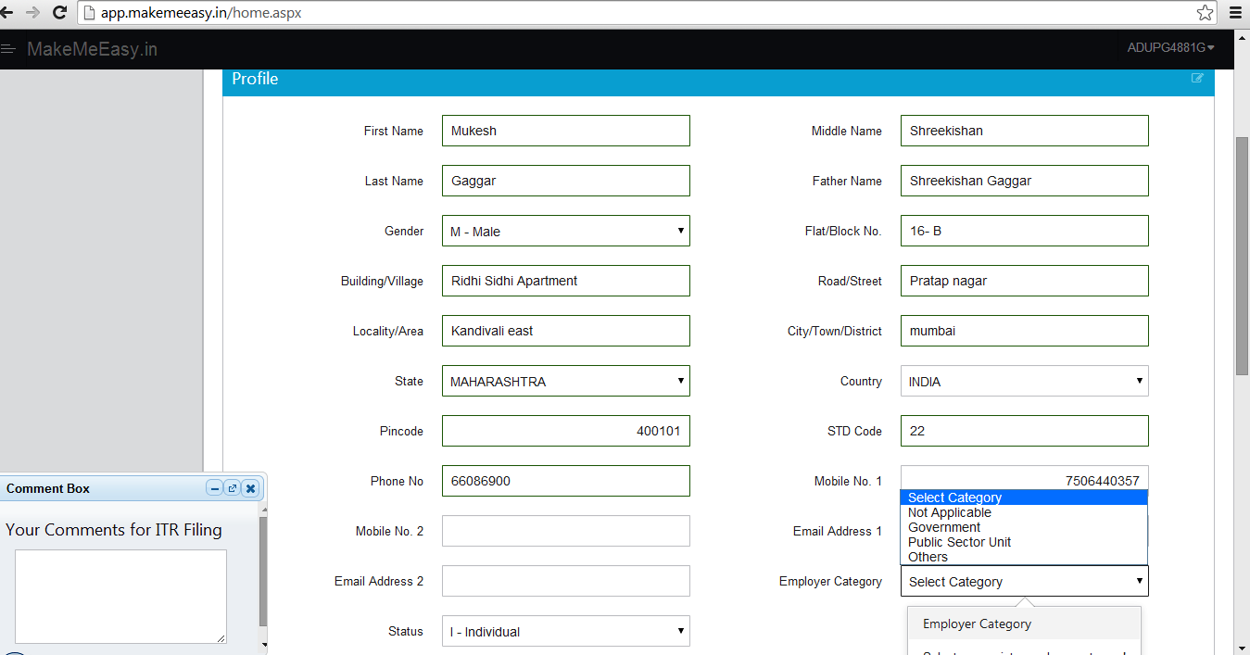
Step 2: This will be your next Page.

Slide 9
Personal Details. and fill the profile Page with Full Detailed Information .
Select : Employee Category : ” Others”.
Select: Status: “ Individual”

Slide 10
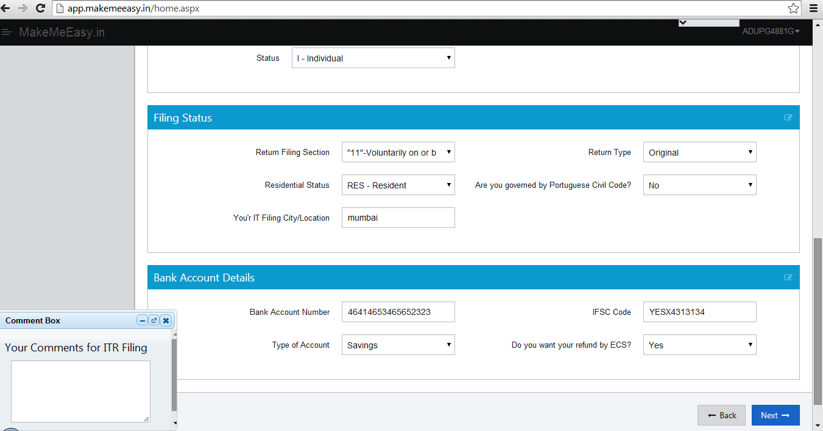
Filling Status

Slide 11
Return Filling Status : “ 11”- Voluntarily on or before the due date under section 139 (u/s 139 (1))
“ Filling Status”
Return Filling Status : “ 11”- Voluntarily on or before the due date under section 139 (u/s 139 (1))
Return Type : “Original”
Residential Status: As per requirement
For e.g.
RES – Resident
NRI – Non Resident
NOR – Resident but not ordinary resident
Enter your “ ITR Filling City/ Location.
Enter your Correct Bank Details.
Then Click on “ Next”.

Slide 12
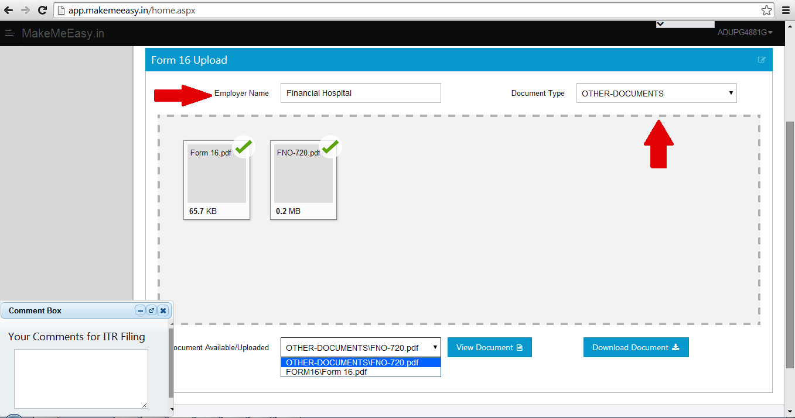
Step 3- Enter Your “ Employer Name” Click on “ Drop files to upload” ( Upload Form 16 in PDF only)

Slide 13
Click on “ UPLOAD ”
Thank you for filling the ITR with us. Our Process team will process your ITR with in 5 to 8 Business Days.

Slide 14

For Any Query, Kindly Contact Us on : Amruta Bhilare : 7506440357 Disha Raina : 7506440355 Tel: +91-22-66086900

